Slide 1
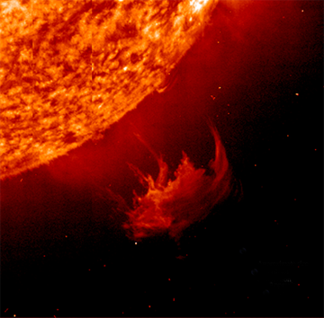

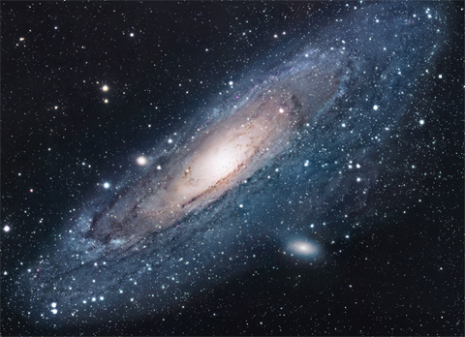

Slide 2
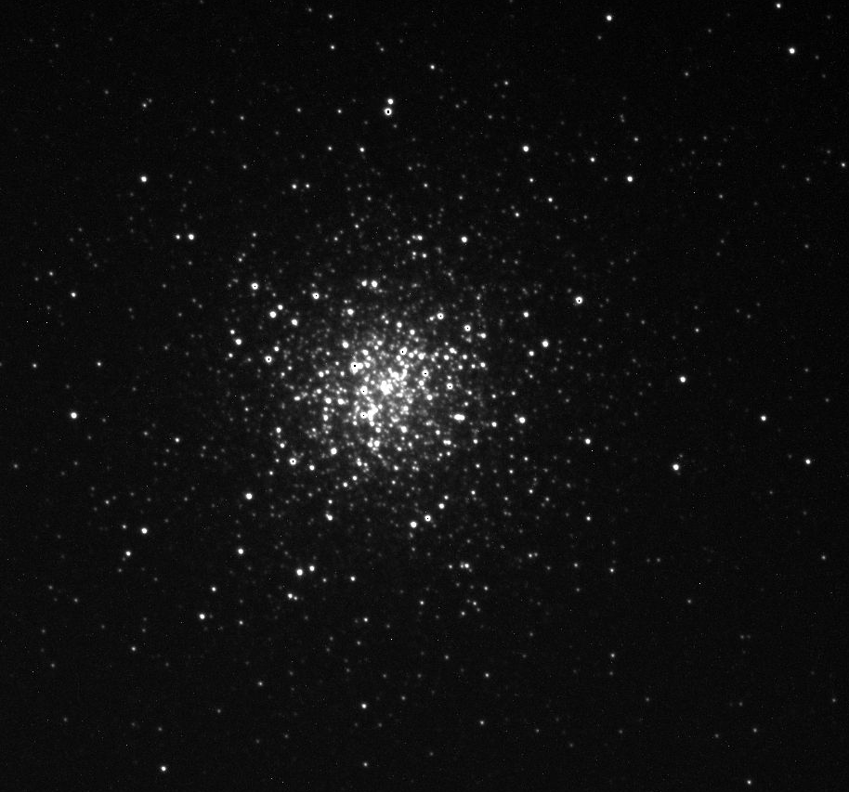
M3 Through the Telescope
M3 is 33,900 light years away from us.

Slide 3
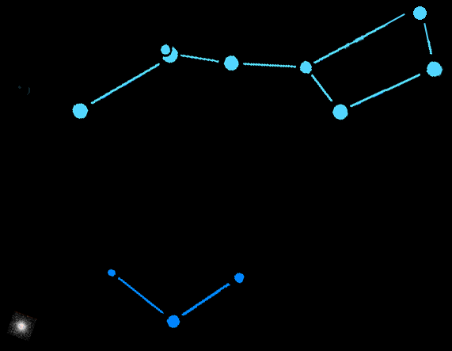
M3
M3 In the Night Sky
M3 is in the constellation Canes Venatici (the hunting dogs) just below the handle of the Big Dipper.

Slide 4
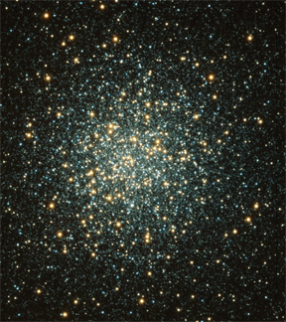
What is M3?
M3 is a globular cluster of stars that is over 160 light years across and that contains about 500,000 stars.

Slide 5
Detailed Image of M3
Of the 200 or so globular clusters in our Milky Way galaxy, M3 is one of the largest and brightest. It is easily visible in the Northern hemisphere with binoculars.

Slide 6
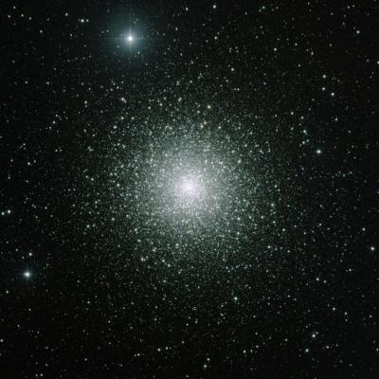
How Big are Globular Clusters?
160 light years
M3 is 160 light years across. At the speed of light (186,000 mi/sec) it takes 160 years for light to cross M3 from one side to the other. – That’s 2 lifetimes!

Slide 7
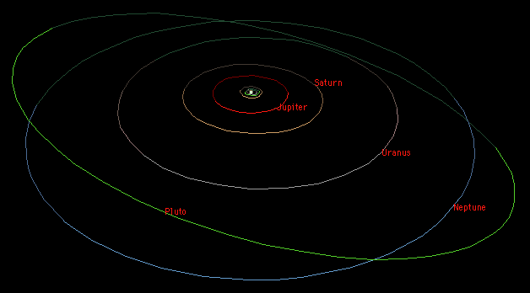
How Big !?
X 175,000 =
It would take 175,000 of our solar systems (as defined by Neptune’s orbit) placed side-by-side to stretch all the way across M3.

Slide 8
How Big !!!?
4 hrs 11 min.
It “only” takes light 4 hours 11 minutes to get from the Sun to Neptune.

Slide 9
What is a Globular Cluster?
A globular cluster is a tightly packed group of about 100,000 or more stars. There are about 150-200 globular clusters in the Milky Way Galaxy.

Slide 10
How Old Are Globular Cluster?
The globular clusters of our galaxy are old! They are the same age as the galaxy itself – at least 12 billion years old.

Slide 11
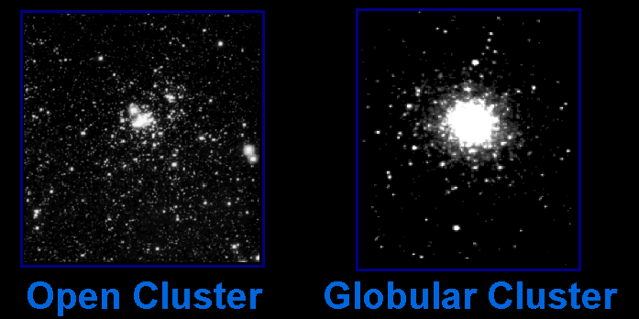
Star Clusters
There are two main types of star clusters in our galaxy …

Slide 12
Star Clusters
Star Clusters
Open clusters orbit within the disc of the galaxy. Globular clusters orbit above and below the plane of the galaxy.

Slide 13
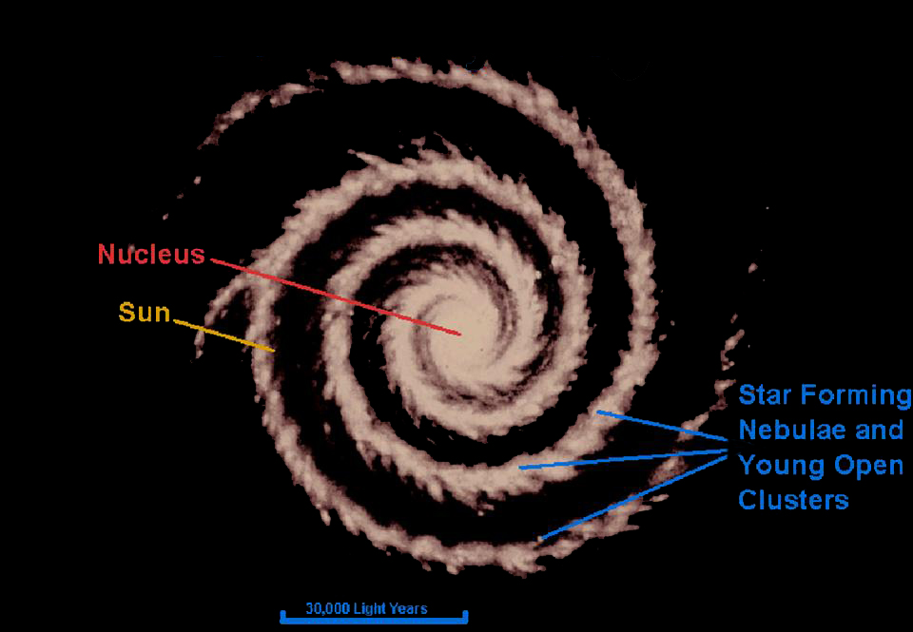
Our Milky Way Galaxy
(top view)

Slide 14
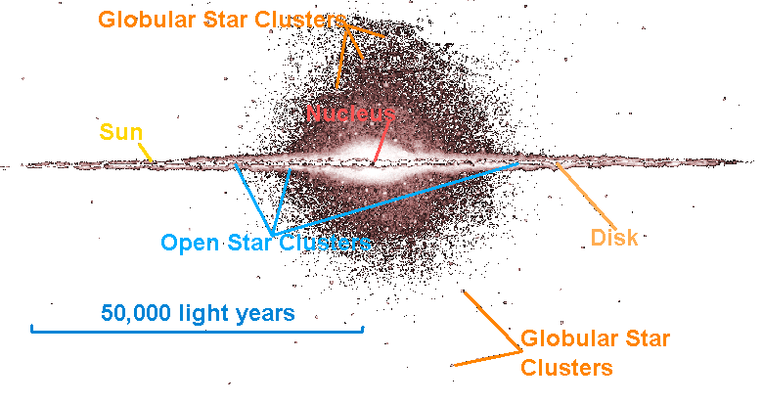
Our Milky Way Galaxy
(side view)

Slide 15
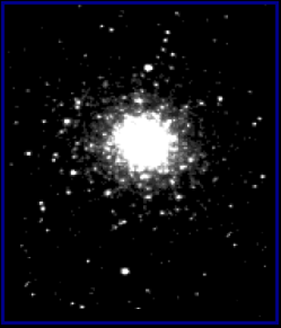

Open and Globular Star Clusters Are Different Sizes
Open Cluster
Globular Cluster
are about 30 light years across.
are about 150 light years across.
Open clusters are 5 times smaller than globular clusters. They only look the same size because they are closer.

Slide 16
Open and Globular Star Clusters Are Different Sizes
Open Cluster
Globular Cluster
have hundreds to thousands of stars.
have thousands to nearly a million stars.

Slide 17
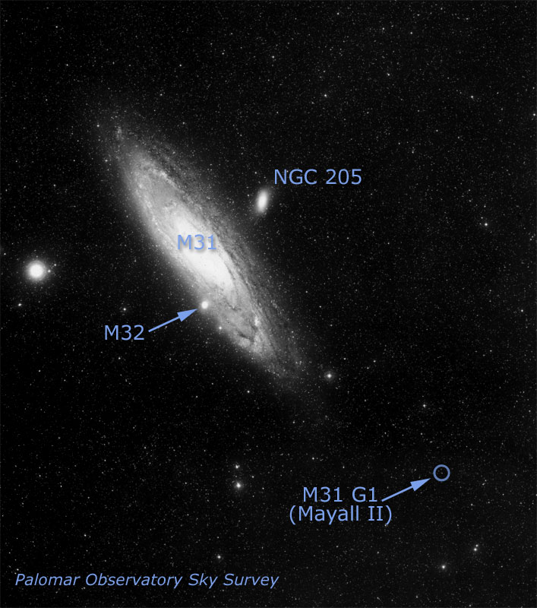
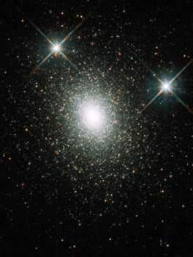
Other Galaxies Have Halos of Globular Clusters
HST image of G1
This globular cluster called G1 is in the halo of the Andromeda galaxy (M31).
This cluster has a medium-sized black hole in it!

